Slide 1
Exception Handling

Slide 2
Objectives of This Session
Identify the need for Exception Handling
State the exception hierarchy
Explain the Try, Catch & Finally construct.
Describe the cascading of exceptions
Distinguish between throw & throws keyword
Create User defined Exceptions

Slide 3

Need for Exception handling
To signal serious problems when a program is being executed.
Also to signal some particularly unusual event in your program that deserves special attention
  Eg: if end of file has been reached, file has been corrupted, file is not found etc.
Notes:
Not all errors in programs need to be signaled – exceptions should be reserved for unusual or catastrophic situations
Reason? Dealing with exceptions involves a lot of processing overheads.

Slide 4
Exception handling in Java
Exception : an OO way of handling errors.
Keeps problem solving & error handling code different.
Thus, program is less complex.
Exceptions in Java are actual objects, instances of classes that inherit from class Throwable.
These objects encapsulate the error information.
Created when a abnormal situation arises in your java program.

Slide 5
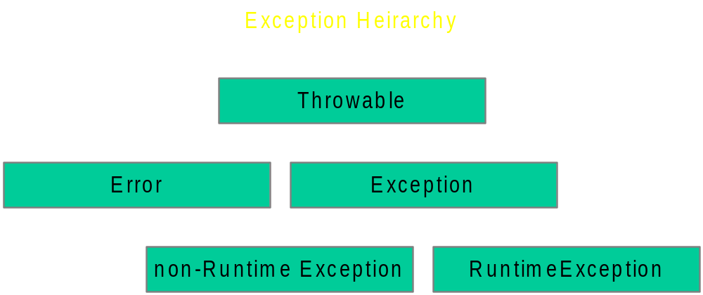
Exception hierarchy
Notes:
If you are familiar with the exception hierarchy in ansi c++, you will be confused.
C++ has 2 exception classes, runtime_error & logic_error. The logic_error is equiv. to java’s RuntimeException & denotes logical errors in prg. The runtime_error class is the base class for exceptions caused by unpredictable problems. Its equiv. to non-runtime classes in java hierarchy.

Slide 6
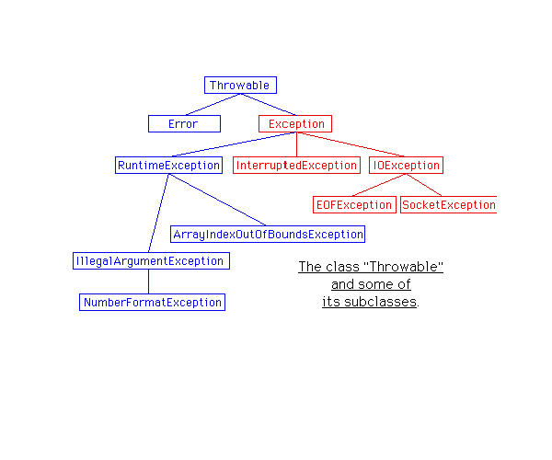

Slide 7
Errors
Are internal errors in the java Runtime environment
Describe internal errors & resource exhaustion in JVM.
Rare & usually fatal.
Used by Java run-time system to indicate errors having to do with run-time environment itself.
  OutOfMemoryError
  StackOverflowError
Notes:
Example 1 : public class AbstractMethodError
Thrown when an application tries to call an abstract method. Normally, this error is caught by the compiler; this error can only occur at run time if the definition of some class has incompatibly changed since the currently executing method was last compiled.
Example 2:
public class ClassFormatError
Thrown when the Java Virtual Machine attempts to read a class file and determines that the file is malformed or otherwise cannot be interpreted as a class file.
Example 3:
public class StackOverflowError
extends VirtualMachineError
Thrown when a stack overflow occurs because an application recurses too deeply.
Example 3:
OutOfMemoryError
Thrown when the Java Virtual Machine cannot allocate an object because it is out of memory, and no more memory could be made available by the garbage collector.

Slide 8

Runtime Exceptions
Happens because user made a programming error .i.e code was not very robust.
Includes such problems as:
  A bad cast
  A out-of-bounds array access
  A null pointer access
Example:
  NullPointerException
  IndexOutOfBoundsException
Notes:
Example:
NullPointerException
IndexOutOfBoundsException
SecurityException
ArithmaticException

Slide 9
Non-RuntimeExceptions
Occurs due to problems in the environment , settings etc.
Includes such problems as:
  Trying to read past the end of a file
  Trying to open a malformed URL
Examples:
  EOFException
  MalformedURLException
Notes:
Examples are:
EOFException
MalformedURLException
ClassNotFoundException
NoSuchMethodException

Slide 10
try-catch-finally clause
try{
…………..
}
catch( <exception> ){
…………….
}
finally {
………….
}
…………….
……………….remaining code continued…………..
………………..
Notes:
Here discuss the flow of control in the try, catch and finally blocks and in the code following these constructs
for the following three scenarios
Exception occurred and caught
Exception occurred and not caught
Exception did not occur

Slide 11
cascading of exceptions
try{
………..
// some exceptional method
……….
}
catch(NullPointerException e) { ………..}
catch(RuntimeException re) { ………..}
catch(IOException ioe) { ………..}
catch(Exception e) { ………..}
catch(Throwable t) { ………..}
Notes:
Here explain that the uppermost catch is the most specific exception and the last catch should be the most generic exception class.
Linkage : Complete Reference

Slide 12

Important points
Sub class cannot throw more Exceptions than the super class.
If the method throwing an exception does not catch it , the method must declare that it throws that exception.
The exceptions can cascade from one method to its caller and so on till finally the main() throws the exception
The catch block can contain code for
  Rectification of the error if possible
  Display the error in a customized user friendly way.

Slide 13
User defined exceptions
class MyException extends Exception {
MyException() { }
MyException(String s)
{
super(s);
}
}
Notes:
Your code may run into a problem that is not adequately described by any of the std exception class.
In this case , its easy to create your own exception class.
Derive it from Exception class or any of its sub classes.
Should contain a default constructor & a constructor with a message string.

Slide 14
User defined exceptions
class ExceptionDemo {
public void myMethod() throws MyException
{
….
if(<some condition>){
throw new MyException();
}
……
}

Slide 15
User defined exceptions
public static void main(String args[ ]) {
try{
ExceptionDemo e=new ExceptionDemo();
e.myMethod();
}
catch(MyException e) {
// handle the exception
}
}

